Slide 1
Rewiring How We Respond to Insider Risk
Clea Ostendorf, CISSP
Field CISO
November 2023

Slide 2
Clea Ostendorf, CISSP
Field CISO, West
Clea.ostendorf@code42.com
Notes:
Hi I’m Clea Ostendorf, I have been with Code42 for the last four years. Prior to that I worked in Application Security, and prior to that in tech sales.
My role at Code42 is to support our customers and prospects in building insider risk management programs that are realistic for their environment and bandwidth. No two programs are the same, but they all follow similar fundamentals regardless of size or budget.
It’s through these sessions we come across two types of customers, those who have no idea where their data is moving and they need to get their arms around the scope and breath of the problem, and the more mature organizations who are trying to shift left, and take a risk based approach to data loss.

Slide 3
Notes:
Show of hands, who has an insider risk program?
Insider threat program/?
DLP program?
Who is being tasked with figuring this out sometime this year?

Slide 4
$180 Billion to $540 Billion
Notes:
Does anyone want to guess what these numbers mean?
The total theft of U.S. trade secrets accounts for anywhere from $180 billion to $540 billion per year

Slide 5
A big problem
32%
YoY Growth in events
$16M
Average cost of an incident
75%
Believe it will grow
Source: Code42 2023 Data Exposure Report
Notes:
If you are wondering why this is becoming top if mind for your organization and all of a sudden your board and executives are asking what you have in place, it’s because:
Data Loss from Insiders is a Growing Problem
32% YoY growth of incidents
75% say it will increase in the next 12 months
Average cost is $16M
Another report I looked said one in 4 data breaches has an insider element.

Slide 6
Why?
VOLUME
TECHNOLOGY
PSYCHOLOGY
SEA
SOAR/SIEM
DLP
UEBA/UAM
Notes:
What makes this problem so challenging?
The volume of alerts make it hard to Identification of actual risk –does anyone have alert fatigue in here?
Responding in an effective way – many aspects of insider risk cannot be automated away, although there are places you can automate responses.
Finally, insider risk is a human problem. Mitigation of new events means you have to work with your peers to shift their habits.
–I like to think about phishing in this example, how many times have we been trained on phishing? We’ve gotten smarter –not 100% of course, but we’ve reduced the likelihood of a breach by phishing just by educating our users. You can do the same thing with educating your users on the behaviors you want to see.

Slide 7
Malware Risk
Insider Risk
Bad Actor
Fast Moving / Propagating
Isolate / Disconnect / Quarantine
Interrogate
Security can handle response
Never accidental
Education useless
You can get fired for not reacting
No hesitation about legal issues
I have years of expertise
Colleague
Contained / Doesn’t Spread
Investigate / Understand
Question
Need HR and maybe even Legal
Often accidental
Education critical
You can get fired for over-reacting
No idea what the legal issues are
I THINK have years of expertise
Notes:
Let’s take this comparison as an example.
How many of you would know what to do if you found malware in your environment?
What about if you found your peer was systematically taking project plans and emailing it to their personal accounts?
Exactly, this is not your typical security challenge where it’s a blue team affair. With insider risk, there’s a nuanced delicate balance around detection, response and future prevention.

Slide 8
A very real problem
Non-malicious Departing Employee Coordinated Spy
Notes:
Let’s look at a few recent examples how insider risk manifested
Three Real World Examples:
Boeing:
Sometimes seemingly harmless actions can pose a significant security risk.
In 2017, an employee at global aerospace company Boeing emailed a spreadsheet to his wife — who wasn’t an employee — hoping she could help him resolve formatting issues.
Unbeknownst to the employee, the spreadsheet contained the personal information of approximately 36,000 of his coworkers in hidden columns.
By bypassing security protocols and sending the spreadsheet to an unsecured device and non-employee, he compromised employee ID, place of birth and social security number information.
While Boeing says it’s confident the data didn’t move beyond those two devices, it offered all affected employees two years of free credit monitoring. Credit monitoring costs about $100 per year, so two years for 36K people that’s $7.2Million dollars an innocent mistake cost them.
Pfizer - Last year, pharmaceutical company Pfizer recently sued two former employees, accusing them of stealing internal documents, including trade secrets related to diabetes drug research, and taking that information to start their own drug company. The accused ex-employees downloaded hundreds of files that would give them a leg up in starting their own company.
This is the most common use case we see. 67% of departing employees take data with them, some of that data could have direct impacts to the business.
Appian - probably the biggest insider risk case we’ve seen in years, strait out of a movie.
Coding automation company Appian was awarded $2 billion in damages for trade secret misappropriation after a jury found that competitor Pegasystems hired an employee of a government contractor to essentially spy on Appian to learn how to better compete against its rival.
Pegasystems was not worth $2B and now it’s worth a whole lot less.

Slide 9
Trying to get their job done Employee

Slide 10
Notes:
In 2017, an employee at global aerospace company Boeing emailed a spreadsheet to his wife — who wasn’t an employee — hoping she could help him resolve formatting issues.
Unbeknownst to the employee, the spreadsheet contained the personal information of approximately 36,000 of his coworkers in hidden columns.
By bypassing security protocols and sending the spreadsheet to an unsecured device and non-employee, he compromised employee ID, place of birth and social security number information.
While Boeing says it’s confident the data didn’t move beyond those two devices, it offered all affected employees two years of free credit monitoring. Credit monitoring costs about $100 per year, so two years for 36K people that’s $7.2Million dollars an innocent mistake cost them.

Slide 12
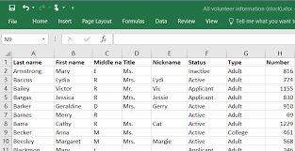

Slide 13
Oops….
the spreadsheet contained the personal information of approximately 36,000 of his coworkers in hidden columns.
36K employees were offered credit monitoring.
That’s close to $7.2M in costs to Boeing not including the labor to identify, investigate, and remediate the breach.
Notes:
two years of free credit monitoring. Credit monitoring costs about $100 per year, so two years for 36K people that’s $7.2Million dollars an innocent mistake cost them.

Slide 14
Departing Employee

Slide 15
Notes:
Pfizer - Last year, pharmaceutical company Pfizer recently sued two former employees, accusing them of stealing internal documents, including trade secrets related to diabetes drug research, and taking that information to start their own drug company. The accused ex-employees downloaded hundreds of files that would give them a leg up in starting their own company.
This is the most common use case we see. 67% of departing employees take data with them, some of that data could have direct impacts to the business.

Slide 18
Corporate Espionage
Notes:
Appian - probably the biggest insider risk case we’ve seen in years, strait out of a movie.
Coding automation company Appian was awarded $2 billion in damages for trade secret misappropriation after a jury found that competitor Pegasystems hired an employee of a government contractor to essentially spy on Appian to learn how to better compete against its rival.
Pegasystems was not worth $2B and now it’s worth a whole lot less.

Slide 20
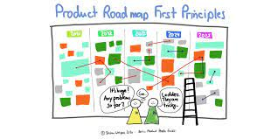
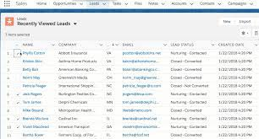

Slide 22
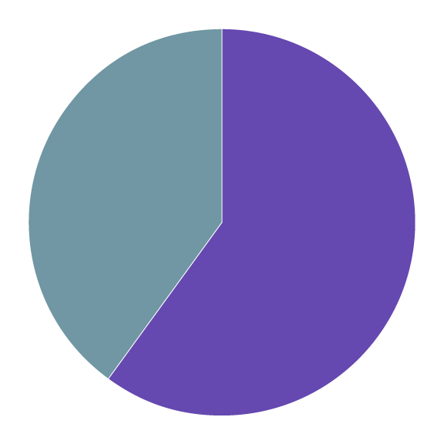
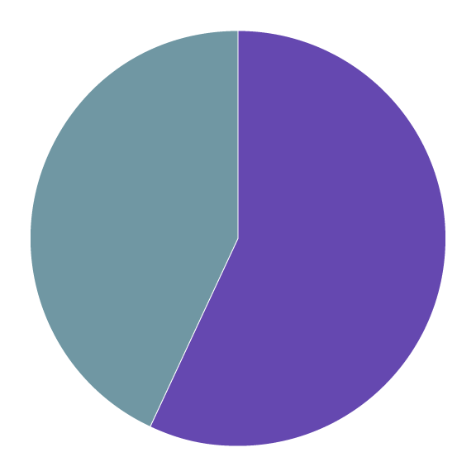
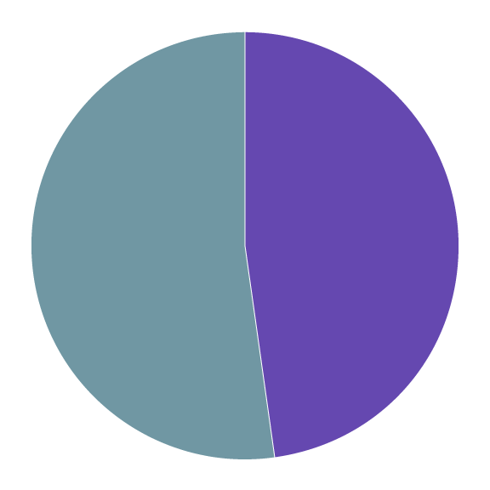
Practitioners Top Challenges
60%
Keeping policies up to date
57%
Collaborating across the company when investigating an event
48%
Measuring the impact of a program
Source: Code42 2023 Data Exposure Report
Notes:
Let’s talk about some of the specific reasons organizations struggle with insider risk programs. Use these to comisoriate or as heads up of what to expect before you start to deploy a program.
The first element is policies. If you don’t know what’s acceptable, it’s going to be hard to configure and respond to any events.
Partnerships. Insider risk is not just a security problem, which is good and bad. Good in that others should have skin in the game and help reduce the likelihood of events, but bad because you have to work with them…and cross functional partnerships can be challenging
Finally, this point is near and dear to my heart, but what’s the impact of the program. So often we are up against do nothing. The business will take the risk. It’s not until there’s one or even two events before they say ok, let’s do something about this. several organizations I’m working with were in the “i’m good” category until they had two incidents back to back.
Any other top challenges you would see here? Anyone want to share one?

Slide 23
Spectrum of Response
Notes:
I have now hopefully validated that this problem is real and this problem is hard. Now I want to share a few ways to address the risk.
From the stories previously, you can tell no single response would have been the best way to mitigate the events that proceeded. It’s a risk forward mindset that reduces the likelihood of an event becoming an incident and your name out of the news.

Slide 24
Three lessons
EXPERTISE
EMPATHY
ENFORCEMENT
Notes:
What does that look like in practice?
Expertise
Empathy
Enforcement
Three Es to keep it easy.

Slide 25
Expertise
PEOPLE
Create a team focused on insider threats, separate from the external threat team.
PROCESSES
Ensure Acceptable Use Policy, communicate goals to employees, have employees acknowledge on a recurring basis.
PROMOTION
Promote a risk aware culture across the entire organization, including up to the board with simple recurring reporting on risk reduction.
Notes:
Let’s begin with Expertise.
To effectively mitigate the risk of data loss from insiders, you need to think outside of just the technology. Building a program does not need to be difficult, but it does requires three key components:
Stakeholders outside of security to help mitigate events before they happen and to respond when one occurs
Playbooks to define your response
The incredibly important aspect of communication & education to help shape desired behaviors in your organization.

Slide 26
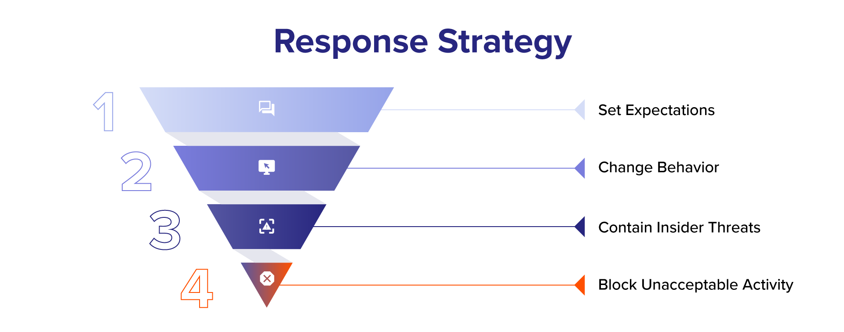
Notes:
I want to double click on one of those points from before. Response.
It is through the spectrum of risk, that you start to think about the response strategy.
Most efforts in an insider risk program should focus on the top two quadrants of this reverse triangle: setting expectations such as policies and guidance on best practices. And then changing the behavior to enforce what you want to see. This could look like communication, micro training, pop up reminders etc. These are essentially the guard rails. By doing this, you can start to reduce the expose and the landscape oyu need to protect.
We see challenges in insider risk programs when the expectations for the organization are not set. For example, no acceptable use policy. This makes enforcement and volume of alerts almost impossible in manage.
The bottom two elements are your tech controls that are necessary for detection and some response such as containment, access controls or blocking of highrisk users.
Let me get a pulse,
Is anyone in this boat today? No acceptable use policy around data practices or a culture that allows anything?
Ok, so what can you do?

Slide 27
People: Don’t do it alone
Create a cross functional team for development and response
Engage with your partners often and early
Be proactive: look at the employee lifecycle
Notes:
PEOPLE
Traditional data loss programs have failed because they don’t take into account bridging a cross functional team in both development and response. Don’t solve this on your own.
To effectively stop data loss from insiders, you need to start at the beginning. That means during onboarding new employees, you cleary share what’s acceptable, what you might be pinged on and how to openly request a tool that is not yet approved.
Let’s think about what’s happening in today’s market. Layoffs.
With layoffs or any other involuntary departures, you’ll be dealing with folks who are suddenly forced to think about what is going on and what to do to protect themselves. This can result in a “grab ‘n go” situation where they may not be in a calm enough state of mind to consider what is theirs to take and what needs to stay.
At the very worst, they may be angry and may try to destroy things on their way out the door. Staying on top of data at the earliest possible point will help mitigate this.
Key takeaway: To help protect data and systems you may want to work with your HR and/or legal teams to request as much advance notice as possible, particularly if there will be a number of people leaving in a short period of time. That’s a lot of potential data walking out the door and you may be able to get ahead of it, if you have some advance warning.

Slide 28
Lay Foundation with Administrative Controls
Acceptable Use Policy
Outlines ownership of data and appropriate use of devices and systems
Program Communication
Inform employees about your program goals, their responsibility, and the monitoring in place to protect data
Role-based and Situational Training
Educate employees differently based on their department, the data they have access to, or where they are in their employee lifecycle
Notes:
As I mentioned, administrative controls are all about building the foundation and defining expectations; essentially setting the organization up for success and to educate employes to be good data stewards and make secure decisions. It’s crucial to inform employees about the program goals, their responsibility, and the monitoring in place to protect data.
George @ SumoLogic, one of our customers finds transparency works best for him. Make it clear in AUP that employees are being monitored but also be very clear what is monitored and what is not. For example, reading emails, reading slack messages, reviewing social media, these more invasive elements should thought through when building your insider risk startegy.
In terms of People, Process, and Technology, the emphasis here is on People and Process
Examples:
Acceptable use policy
Log-on banners
Program comms
Role-based trainings - Proactive or Situational Instructor lessons

Slide 29
Title & Body
SECTION TITLE (ALL CAPS)
Subheading — Proxima Nova Regular, 16pt, Slate (sentence case)
Body Head — Proxima Nova Bold, 14pt, Twilight (Title Case)
First level body copy — Proxima Nova Regular, 12pt, Graphite (sentence case)
Notes:
Finally, in the people rhelm, you need to talk about culture.
We believe, and we’ve built our strategy around protecting data but doing it in a way that builds a risk aware culture vs a security team with a hammer. We look at this with three T’s: transparency, training, and technology.
It begins with transparency on what risks are exposed in the organization.
It moves to training in a proactive, situational and responsive approach that reduces the risk over time
And finally, aligns with a technology suite that allows security team members to identify risks, not slow down staff members who are doing their jobs. It also must be easily shared that data with stakeholders outside of security.

Slide 30
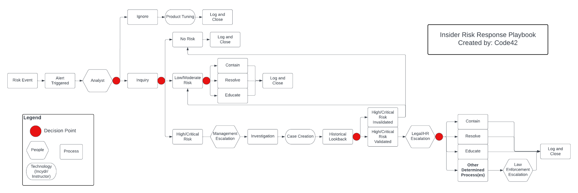
Processes: Define Your Playbooks
Notes:
Ok ok, this is all the soft stuff, show me a playbook.
In security, there are the events we can predict, and there are the ones we react to. With insider risk, defining who and how you respond will cut down on the time and energy it takes to mitigate the data exposure.
For example: When do you pass the case to legal or HR vs involve a manager to validate the business use case? What type of exposure can be mitigated with a training video, and what should kick off a containment playbook? Bonus points for adding in new frameworks of automation.
Your key takeaway: build the playbooks for what you know will occur, for example
Employee lifecycle events
Accidental syncing
3rd party sharing
Playbook Credit: Matthew Kraft

Slide 31
Promotion: Communicate & Educate
What are the lines the employee can work within?
Meet your employees where they interface, communicate there.
Use real time learning to shape behavior & reduce risk over time.
Notes:
I really like this image because it helps me visulize what an insider risk program should do. A good program should not effect employees day to day lives, they are move as fast down the lane and collaborate freely but when they do something that puts company data at risk, there is bumper to course correct and get them back on track.
In a practical manner,
Meet your employees where they are and communicate with them often. For some, that may mean reminders in Slack about best practices sharing data, or it could be in real time training during risky behavior.
In the world of fast moving collaboration, mistakes happen (76% of CISOs expect data loss from insider events to increase at their company in the next 12 months.)
You’re not going to stop everything, that’s why there is technology to show you the unknown,unknowns. Help your employees understand the rules of the game and the lines to draw within. This will go far in taking the responsibility of protecting data from your security team, to the individual. And speaking of communication, how you do it matters.

Slide 32
Empathy
/ˈempəTHē/ noun: The ability to put yourself in someone else’s shoes, see the world from their point of view.
Notes:
As security practitioners, we are experts at creating policies, sending out annual trainings and expecting compliance on them from our employees. It makes logical sense.
But to ensure our employees are able and willing to follow those policies is equally our responsibility and the most successful way to do that is to see the world from their point of view. Only then can we really help them to WANT to be the human firewalls we need.
Building your IRM program around an empathetic approach is key to helping your employees work WITH you to reduce risk. An outcome your HR teams will love and appreciate is that it will improve your company culture because previous animosities between security and the business will evolve into proactive, productive teamwork that secures the company’s data and reputation.

Slide 33
Practicing Empathy: CONNECT
You moved a company file to a personal cloud account. That’s against policy.
Hi! We noticed that a document titled, Onboarding Notes was saved to a non-corporate cloud service. Did you mean to do that?

Slide 34
Practicing Empathy: REASSURE
There are repercussions for breaking security policy.
Don’t panic, we’re not here to reprimand you, we understand that folks make mistakes when we’re moving quickly.

Slide 35
Practicing Empathy: RECOVER
We need a Zoom call with screen share to watch you put it back and delete it from your personal service.
Can I set up a call to help you reverse this?

Slide 36
Practicing Empathy: EDUCATE
Due to this action, you are being assigned our Security Policy training and are required to complete it within the next 10 days.
We have secure ways to save and share data and it’s all summed up in a short training lesson that I’m going to send to you. Please let me know when you’ve watched it so I can answer any questions you may have.

Slide 37
Enforcement
SCOPE
Will it work across all my platforms?
Does it cover all my cloud applications?
My user populations?
SIMPLICITY
What settings do I need to adjust?
What rules / policies do I need to set?
How many FTEs needed to operate/administrate?
How easy is it to run and collaborate on an investigation?
SPEED
How fast can it be deployed?
How fast can you see value?
How fast can you take action?
Notes:
Enforcement is where you want to consider the technology. The two most important things to take away here is coverage and time to value. Find a solution that will cover all the places your employees are sharing data and show you the ones you dont know.
Find a tool that is going to quickly show you where you are exposed and a partner who can help you tune to an effective deployment.

Slide 38
Summary: this problem isn’t going away
TRANSPARENCY
EDUCATION
EMPATHY
Notes:
This problem is not going away. The market is changing from people questioning why they need to think about insider risk, to actively seeking out solutions to solve for this gap. It’s coming from the board, it’s coming from customers and it’s going to be seen in compliance requriements.
When you look to solution this, Think about the inverse triangle on how to structure it. Don’t do it alone, and within your reposne, practice the empathectic ways to communicate with your peers.

Slide 39
Questions?

Slide 40
Resources
https://www.code42.com/blog/insider-threat-examples-in-real-life/

